Slide 1
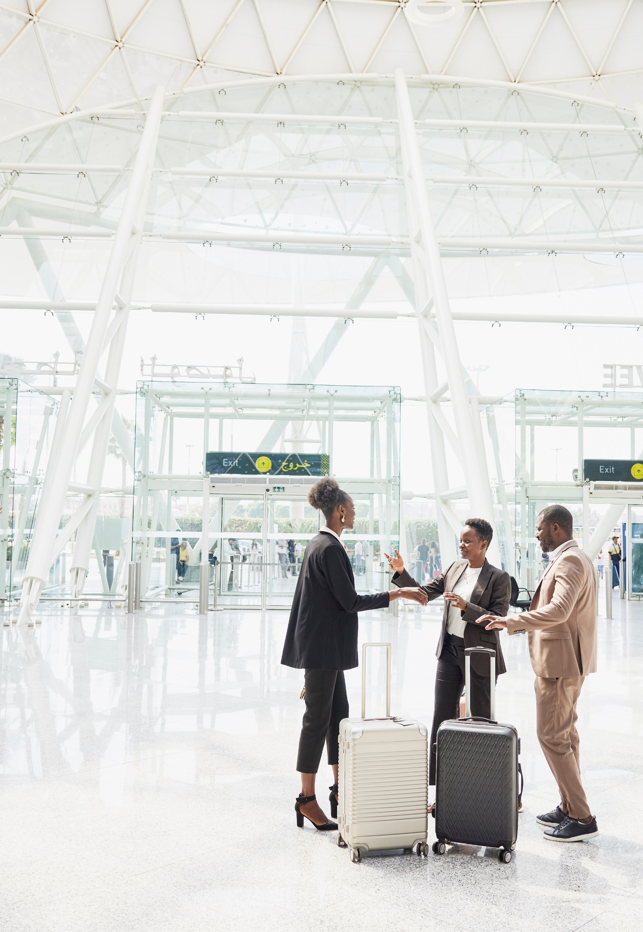

Step-by-Step How to Use Your Profile
Neo User Guides

Slide 2
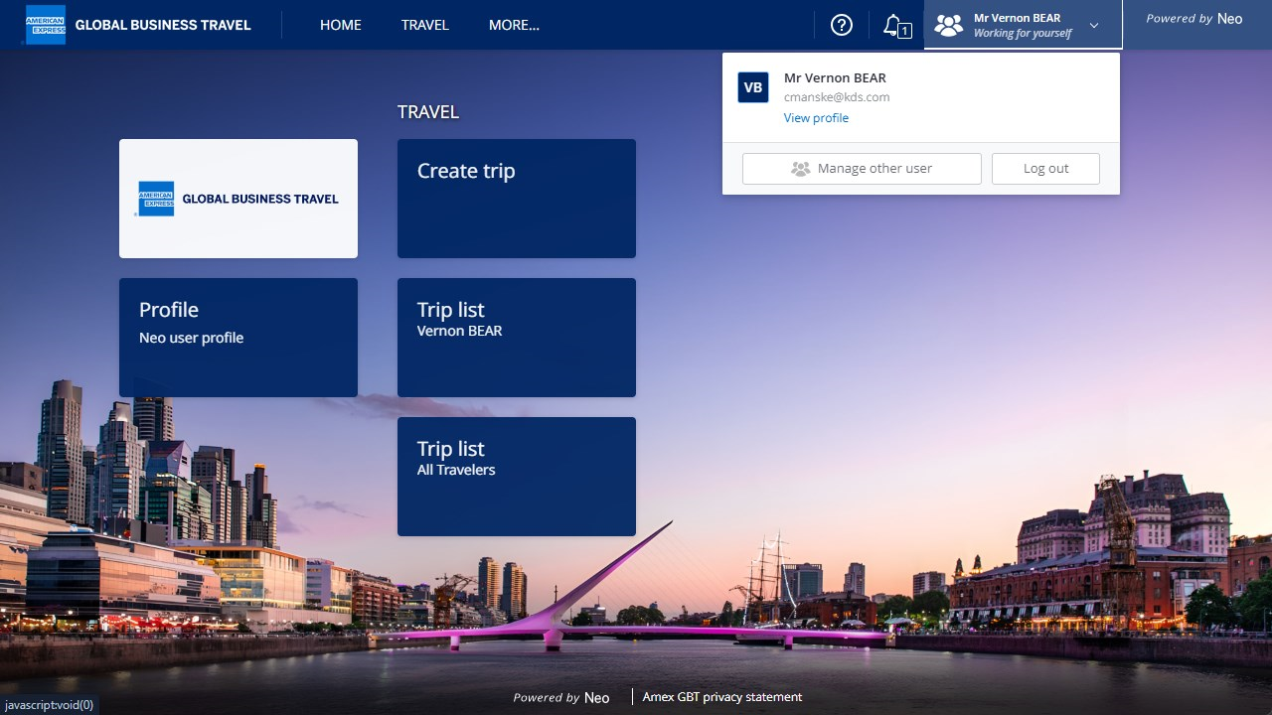
Your profile is accessible by clicking on the tile entitled “Profile”. You can also click on your name and “View Profile”.

Slide 3
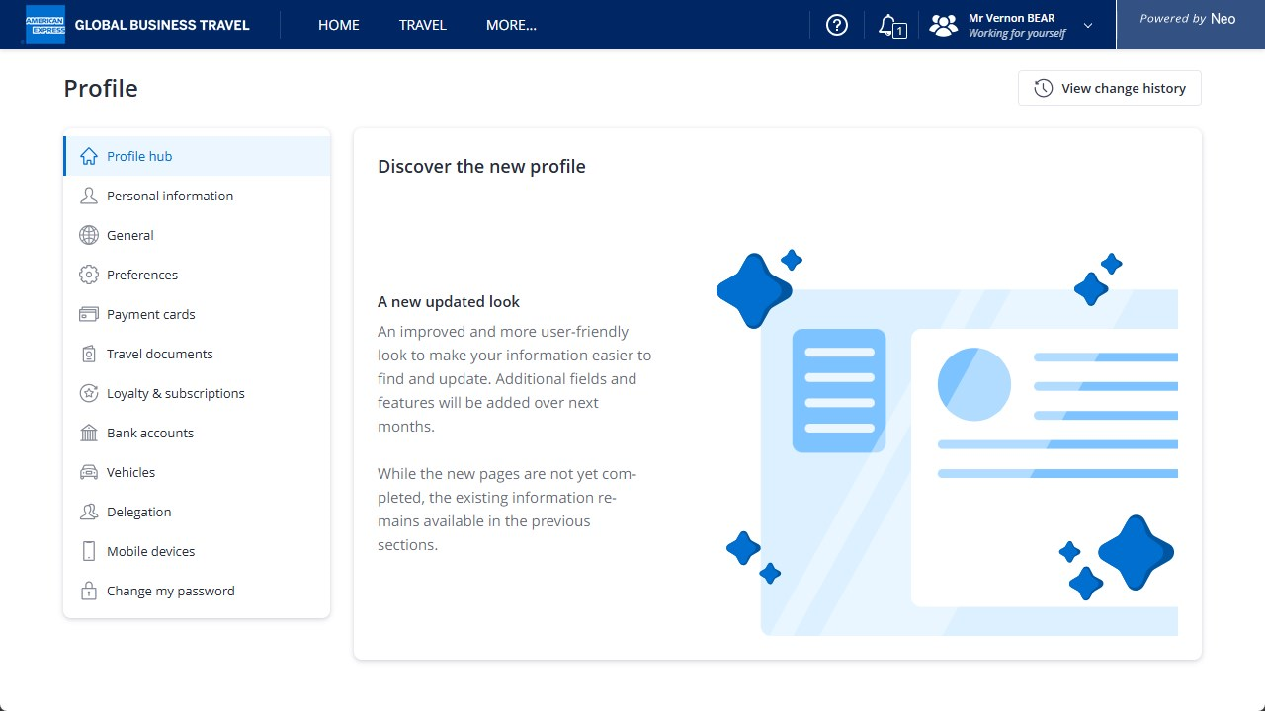
Your profile can be set up and modified by clicking on a category within the menu.

Slide 4
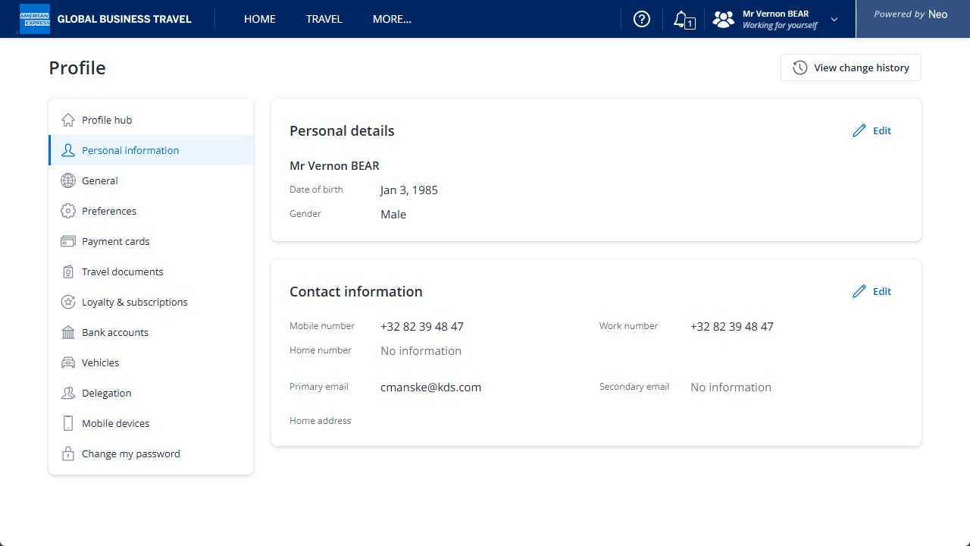
Under “Personal information” you can view and edit details about yourself, including your contact information. Click on Edit to make any changes.

Slide 5
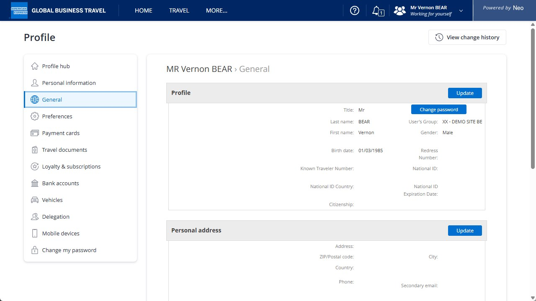
Select “General” to update information such as your name, address, and password… Select “Update” to make any changes, or “Change Password”

Slide 6
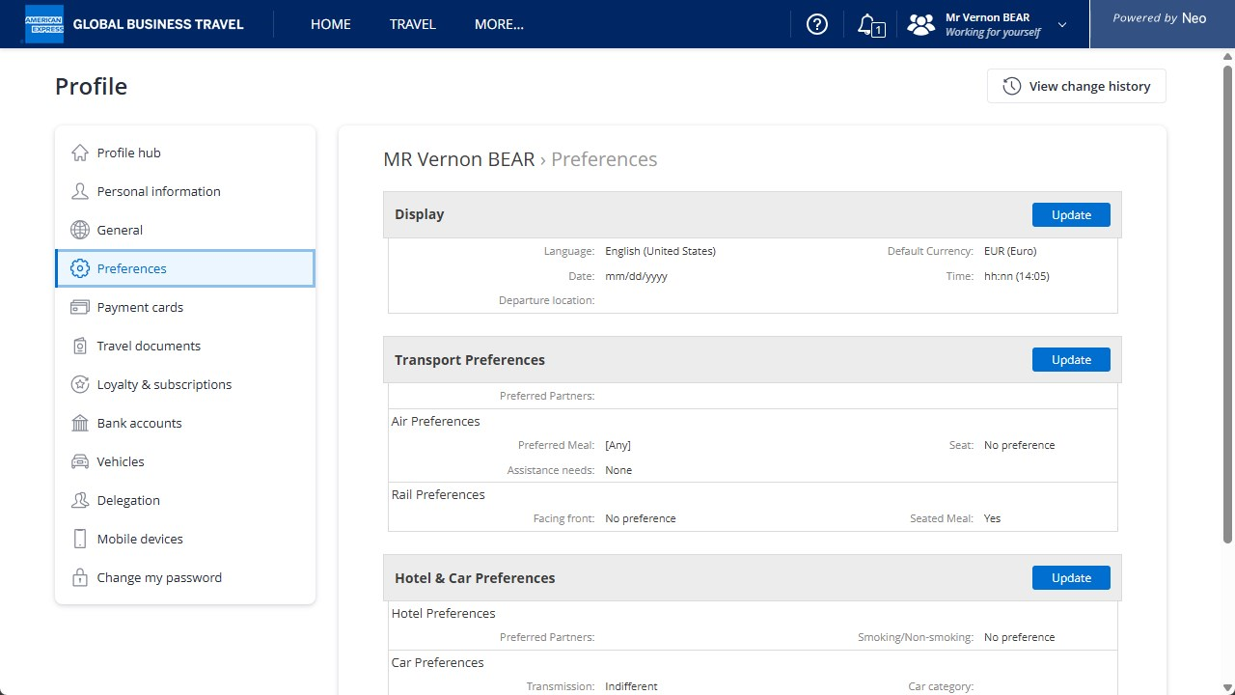
Select “Preferences” to modify the default language, currency, and update your travel preferences.

Slide 7
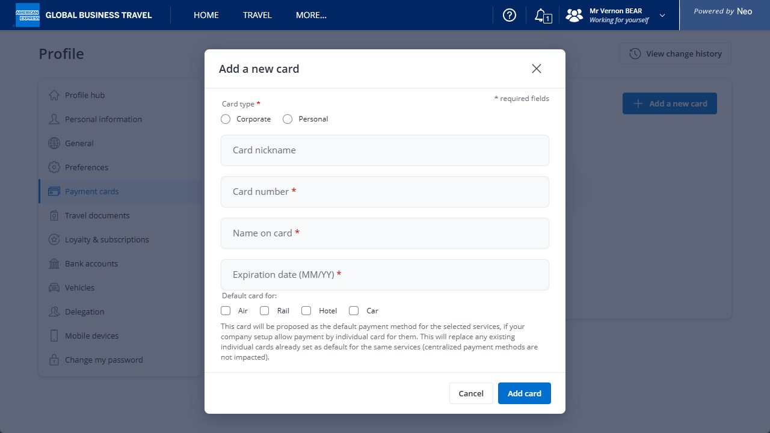
To update or add credit cards and loyalty cards,
select “Payment Cards/Loyalty Programs”.

Slide 8
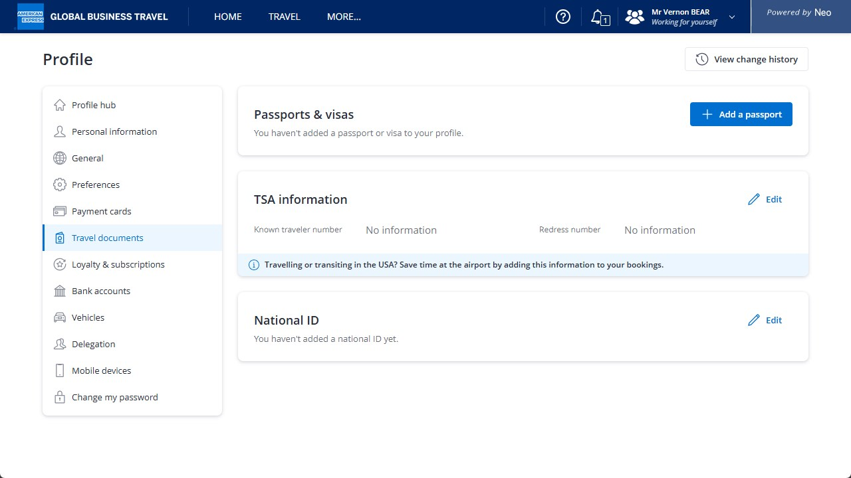
Select “Travel Documents” to view your passports, visas, TSA information and National ID.
Click “Add Passport” to add a passport or visa

Slide 9
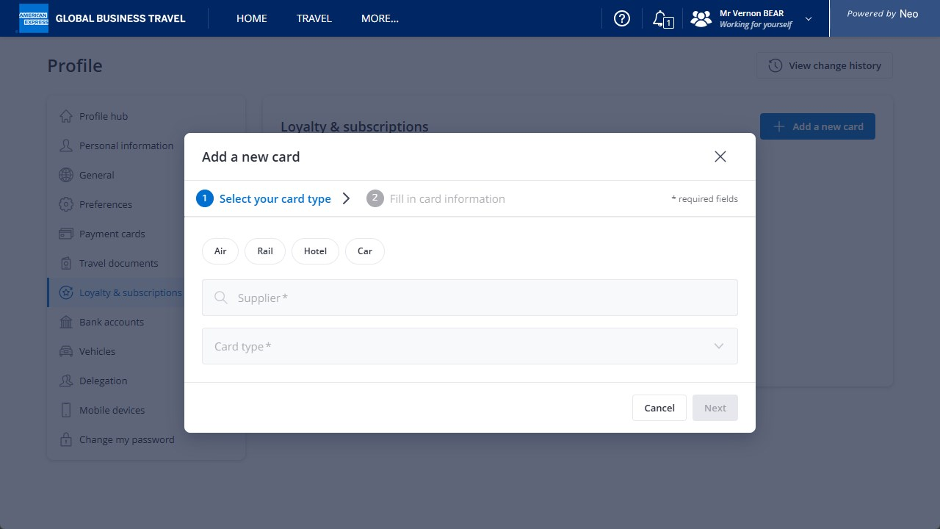
Under “Loyalty & subscriptions” you can add any cards you may have for travel programmes. The possible categories are: air, rail, hotel and car.

Slide 10
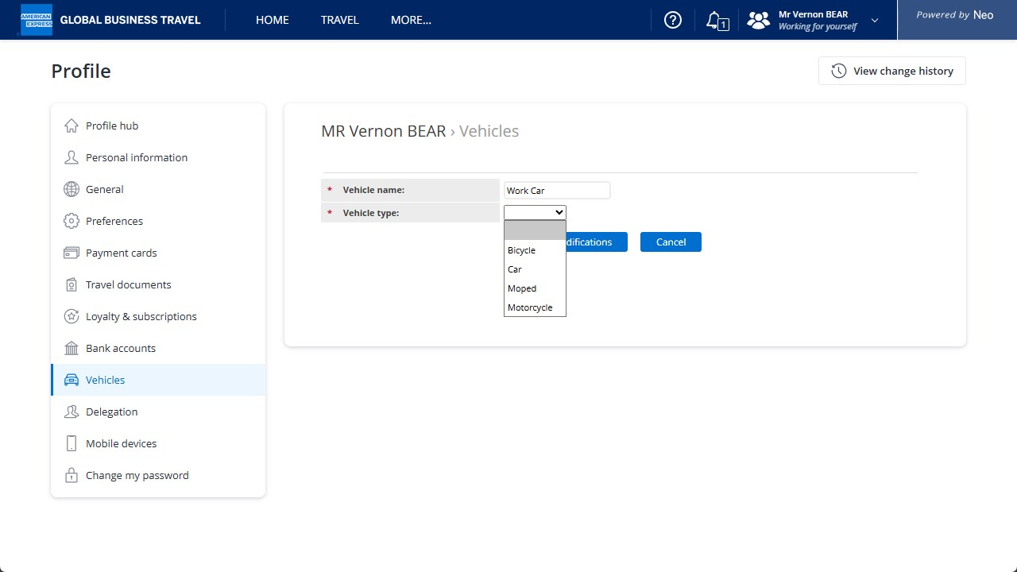
Under “Vehicles” you can add a vehicle, and choose the vehicle type with the drop down menu.

Slide 11
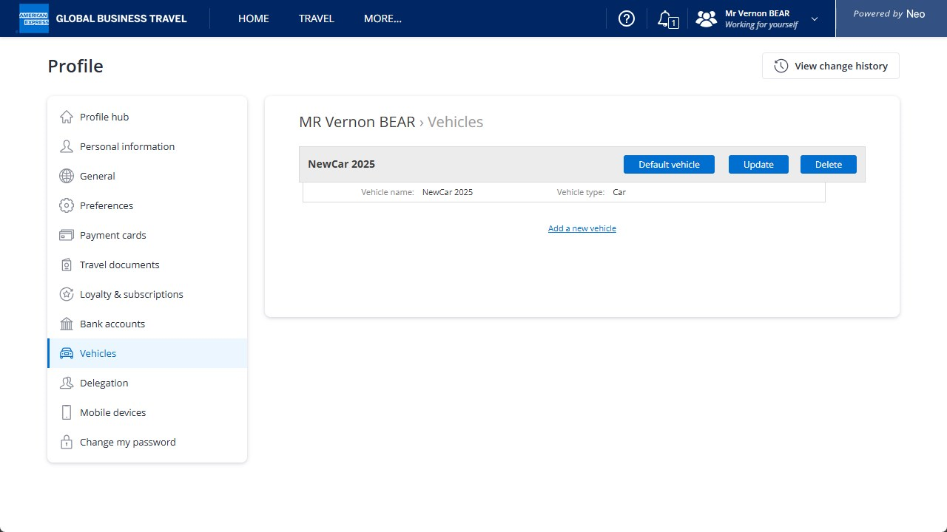
You can click Default vehicle for the designation of a default vehicle in case of several attached to your account.
You must have a vehicle set up in your profile to claim mileage.
It will also enable Neo to suggest car itineraries.

Slide 12
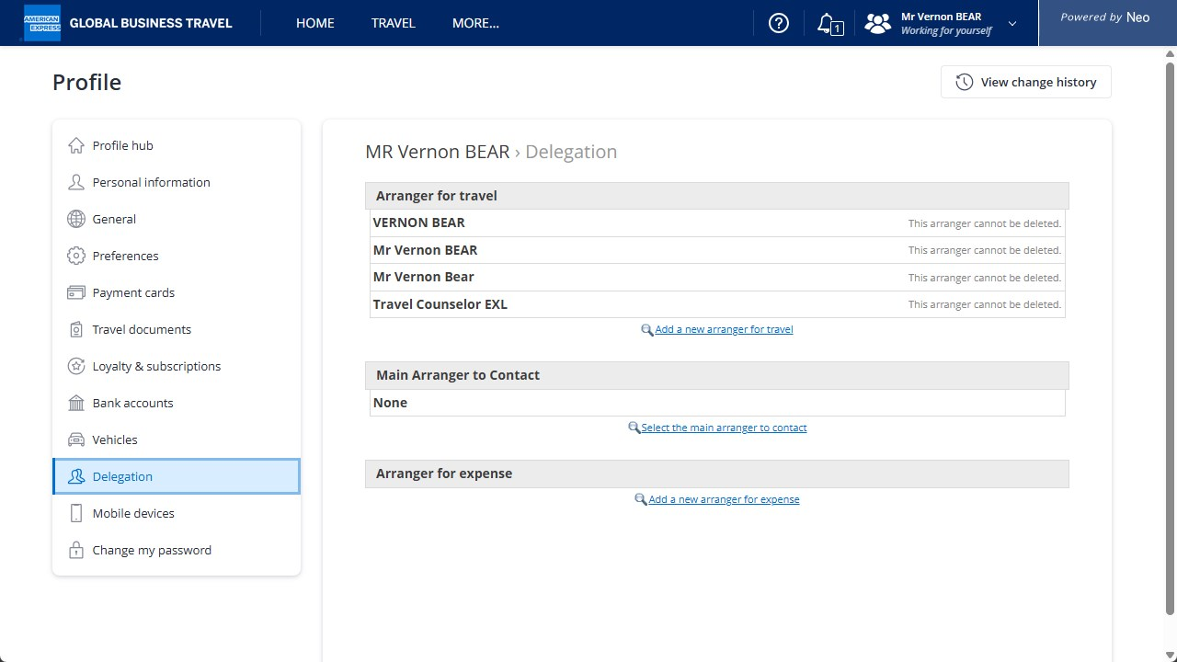
You can manage any delegations under the “Delegation” category. It is possible to add a new arranger for travel, select the main arranger, or add a new arranger for expenses.

Slide 13
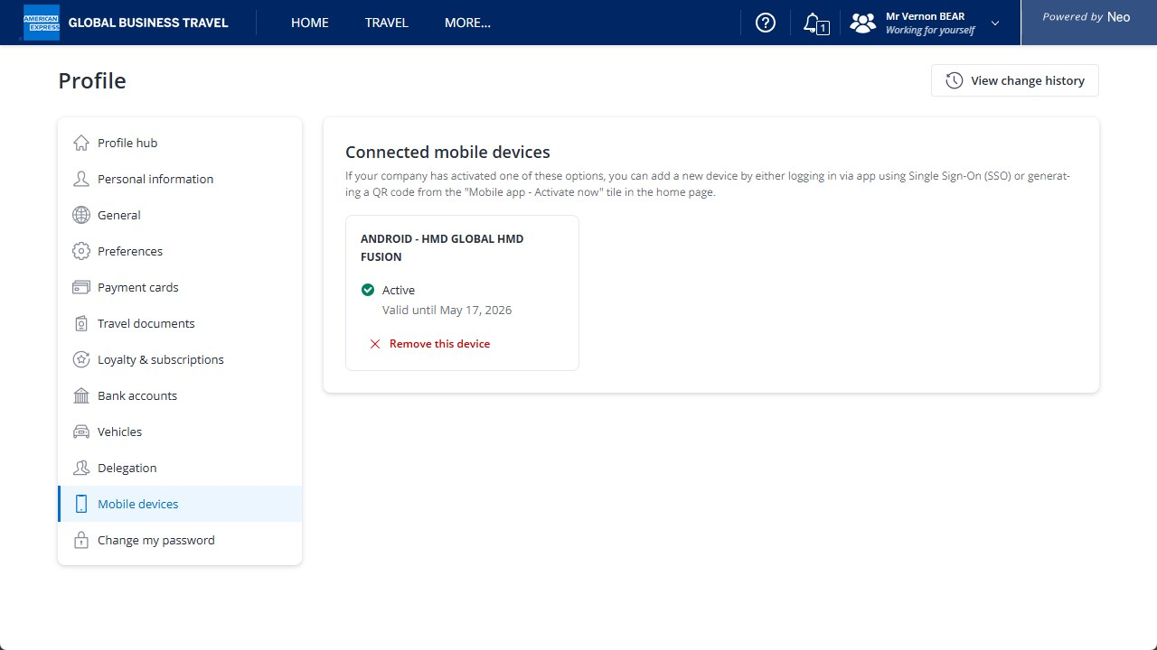
If you have any mobile devices attached to your account, they are viewable under the category “Mobile devices”. Here you have the possibility to see if the device is active, remove the device, and see until when this activity is valid.

Slide 14
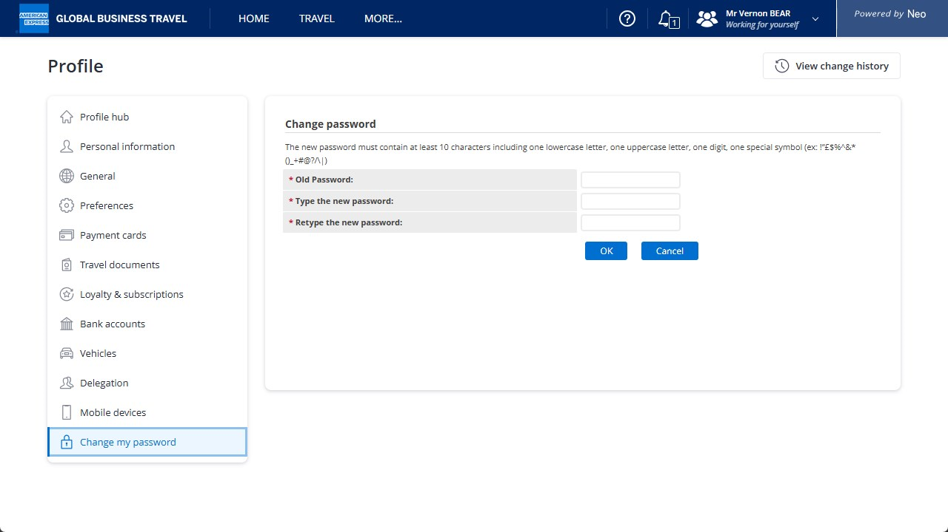
Changing your Neo password has been made easy under the tab “Change Password”.
Remember to press “OK” once the password has been changed.

Slide 15
By clicking “View change history” it is possible to see any changes made to your Neo profile.

Slide 16
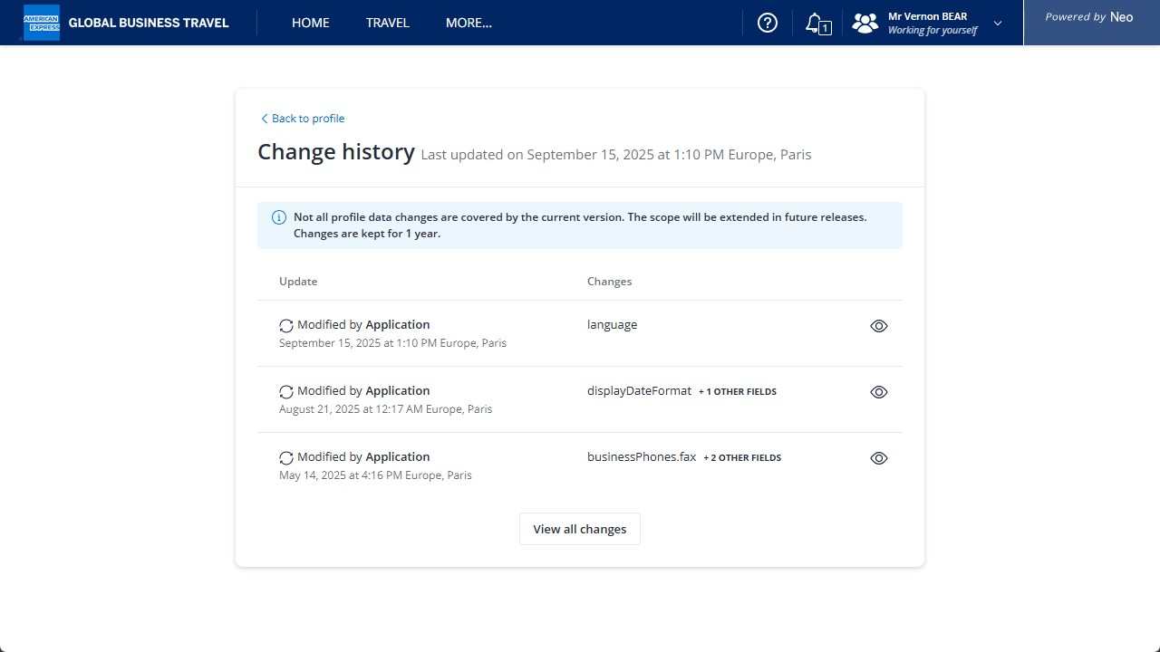
Any changes made to your profile are recorded under the Change history.

Slide 17
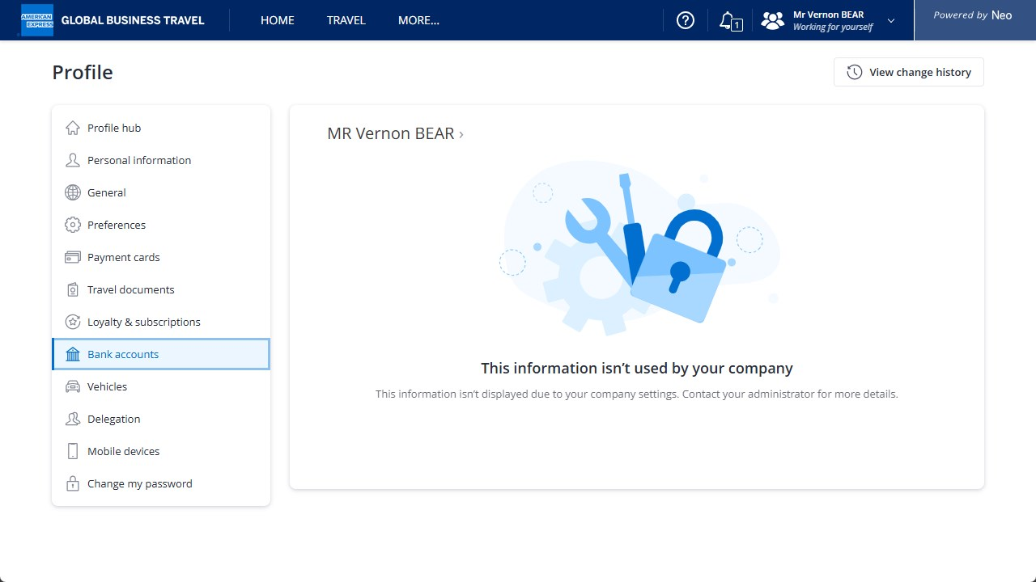
Some information may or may not be used by your company. If it is not used, a message will appear prompting you to contact your administrator.

Slide 18

Travel and Expense.
Simplified.

