Slide 1


Step-by-Step
How to create an expense report on mobile
Neo User Guides

Slide 2
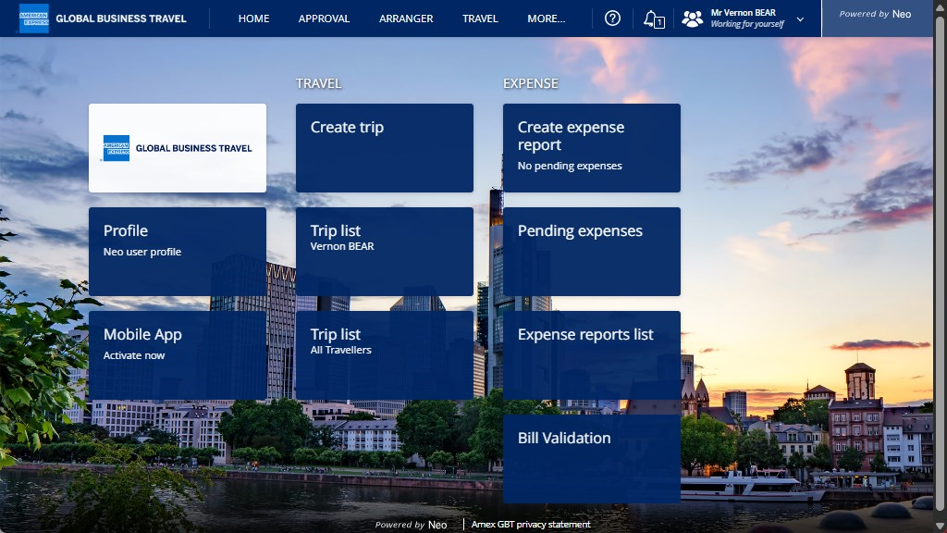
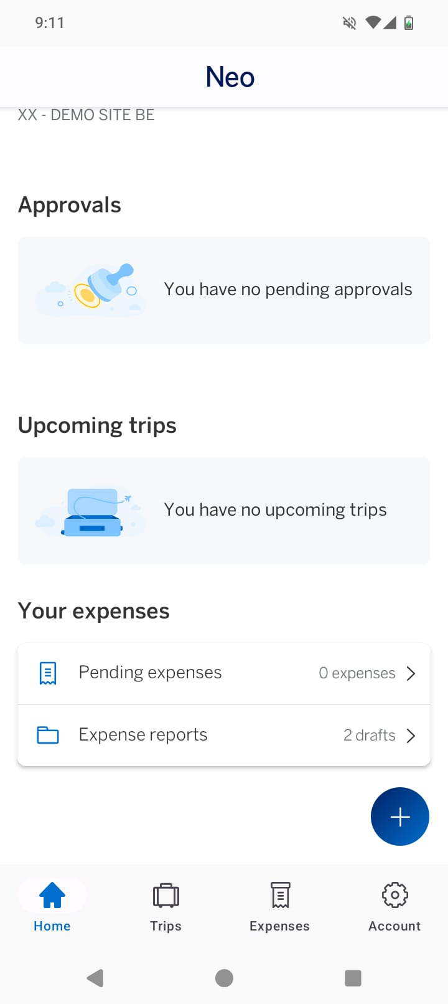
Select “Expenses” or “+”.

Slide 3
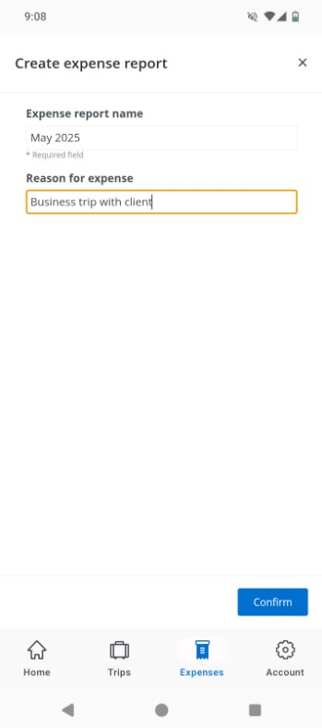
Customise the expense report name and if needed, the reason for the expense (a short explanation for your supervisor).

Slide 4
Select “Confirm”

Slide 5
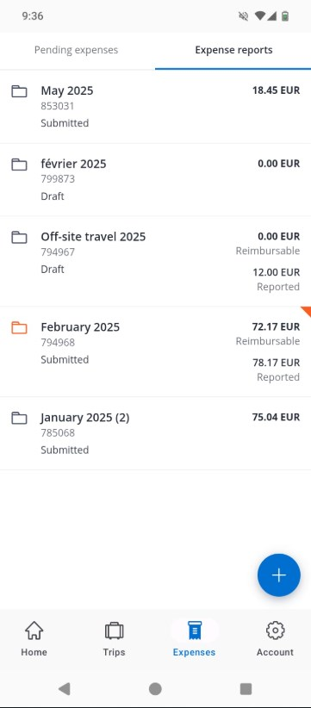
You will find your Expense Report created. To add an expense line, click on the Expense Report

Slide 6
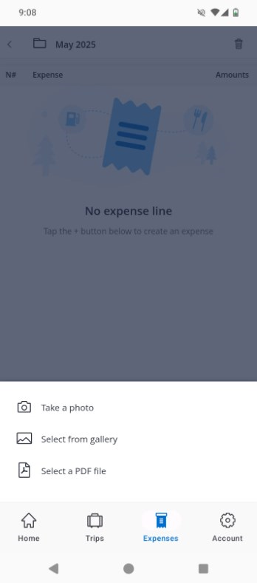
You can now either take a photo of your receipt, select from the gallery or add a PDF file

Slide 7
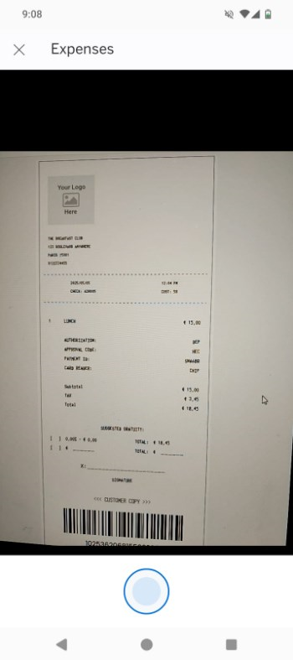
Take a picture of your receipt…

Slide 8
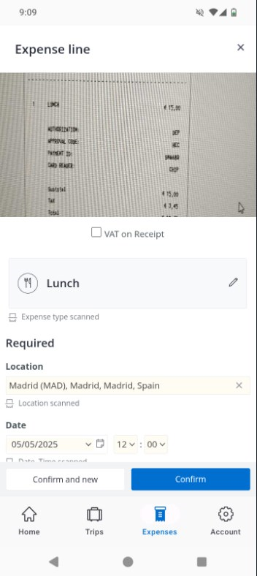
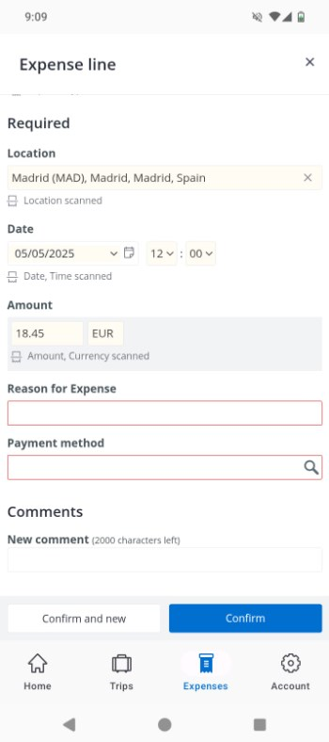
Some information will be automatically populated for the expense line.
If not, it is possible to manually enter the missing data.
You can also add a note for your supervisor.

Slide 9
Once the information is added, select either “Confirm” or “Confirm and new” (useful if there are several receipts).

Slide 10
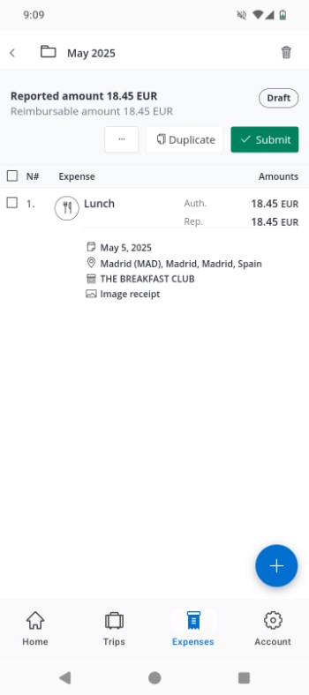
Your expense line will now be added in the Expense Report

Slide 11
If you don’t have anything to add and the information on the expense line is correct, you can now submit your expense line.
You can also duplicate this expense line, and you have even more options under “…”

Slide 12
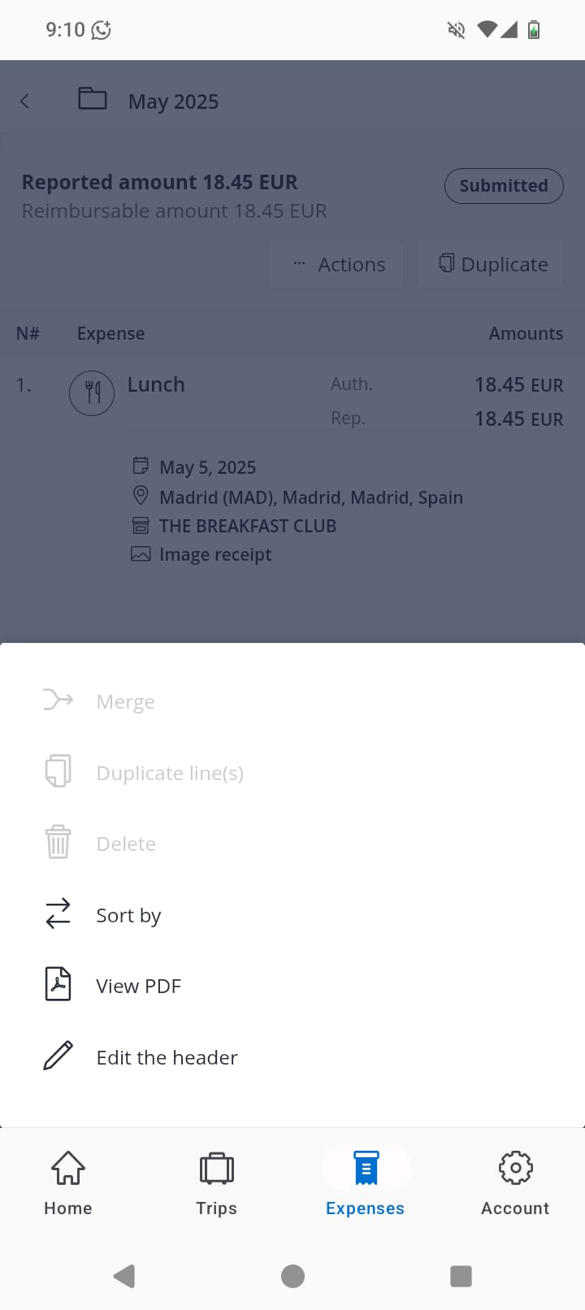
Once submitted, you can click “… Actions” where you can then: sort your expense lines, view the PDF of your expense report, or edit the header (name) of your expense report.

Slide 13
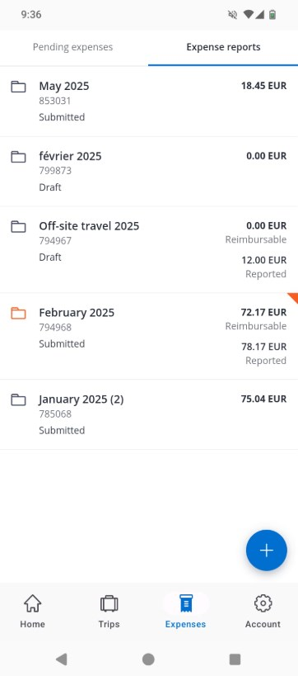
You will find your submitted and draft expense reports again by clicking on Expenses.

Slide 14
If there are any anomalies with your expense report, it will be highlighted.

Slide 15

Travel and Expense.
Simplified.

