Slide 1


Step-by-Step How to Install the Neo mobile app
Neo User Guides

Slide 2
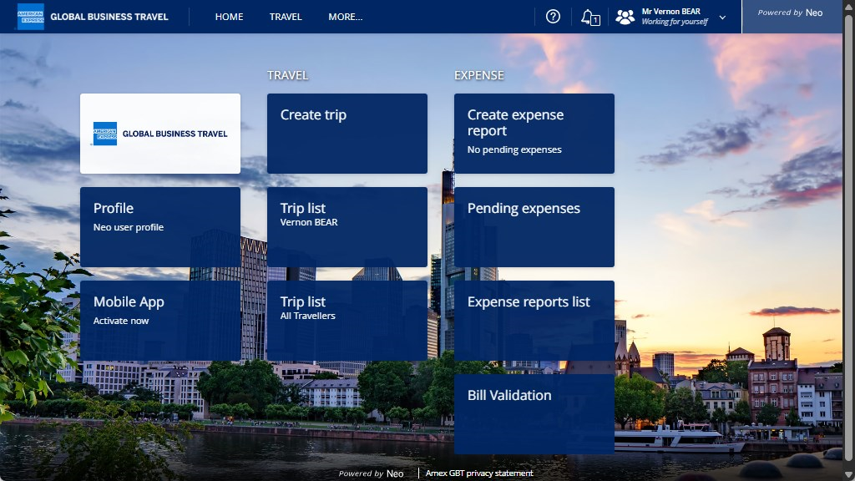
Select
“Mobile App”.

Slide 3
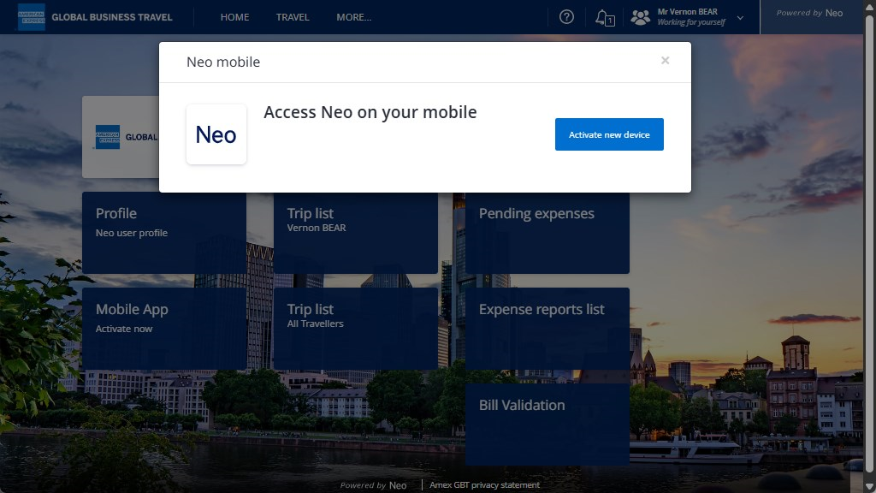
Select “Activate new device”.

Slide 4
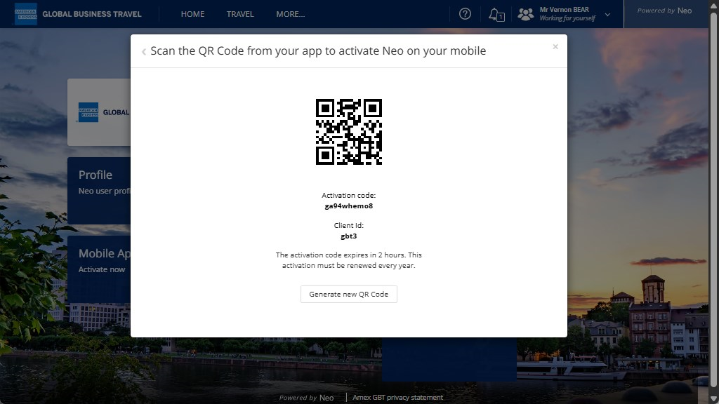
You will need your mobile device ready.

Slide 5
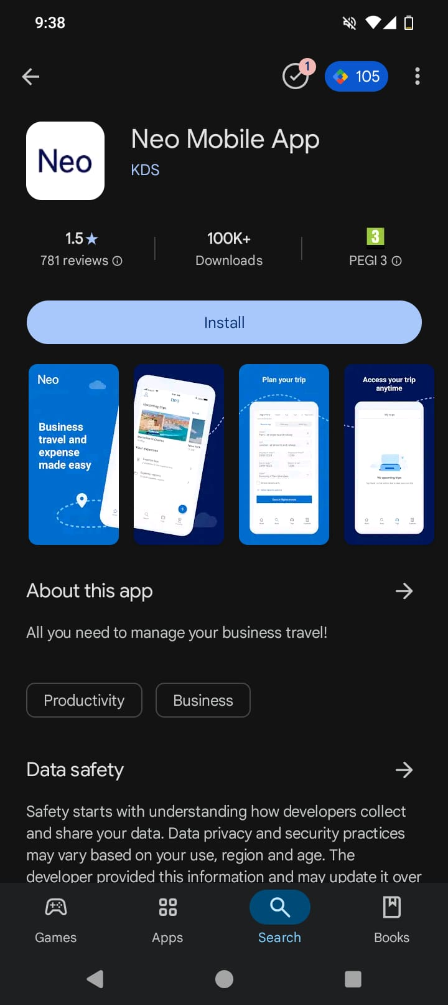
Download and open Neo mobile app on your mobile or tablet.

Slide 6
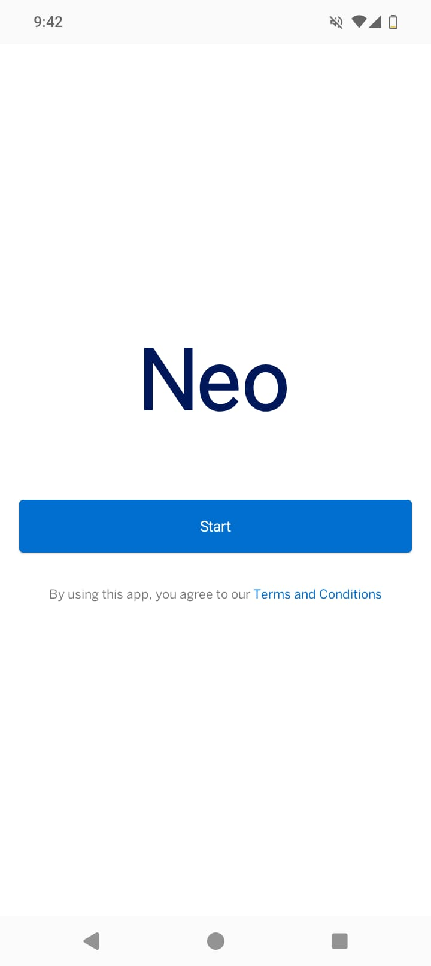
Select “Start”.

Slide 7
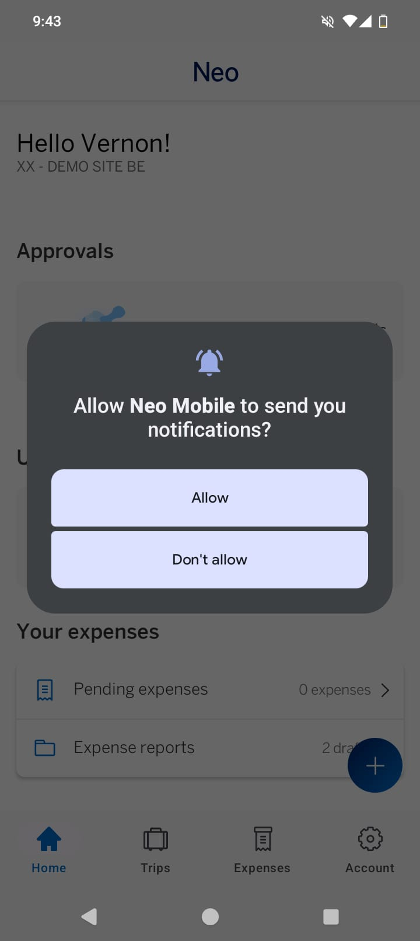
To activate your mobile app using the QR Code, you need to select “OK”.
This is also required to scan receipts.

Slide 8
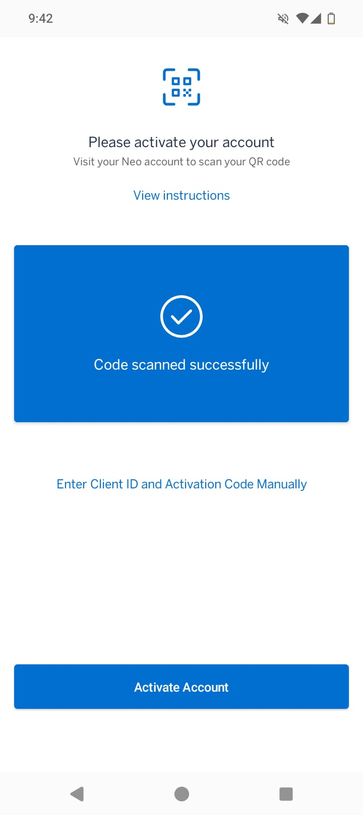
Scan the QR code on your computer screen.

Slide 9
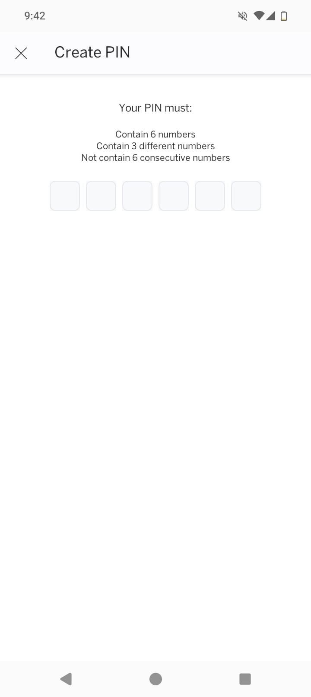
Select a 6-digit PIN code following the instructions.

Slide 10
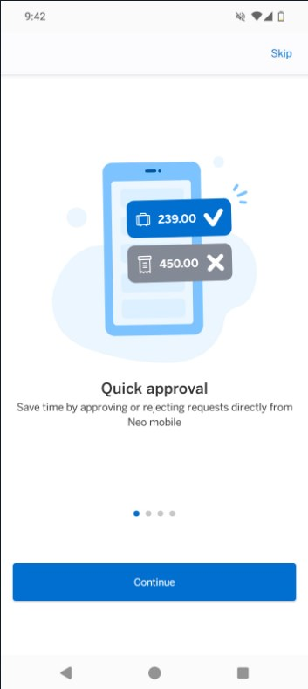
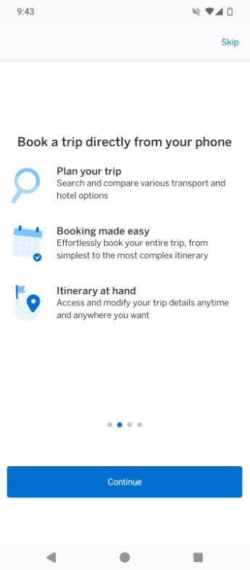
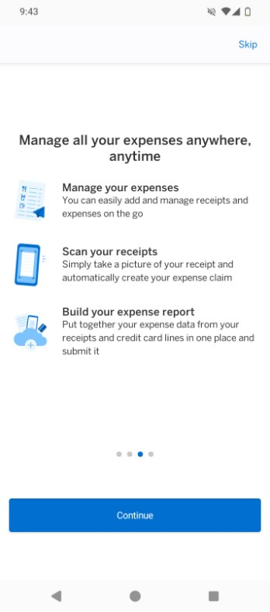
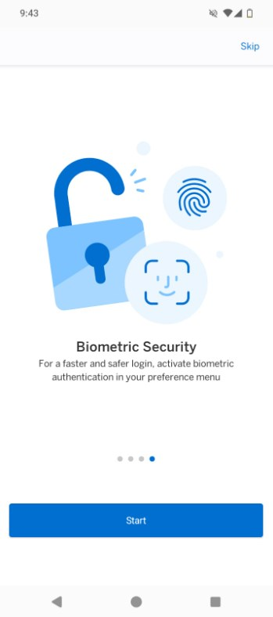
An overview of the app will then be displayed…

Slide 11
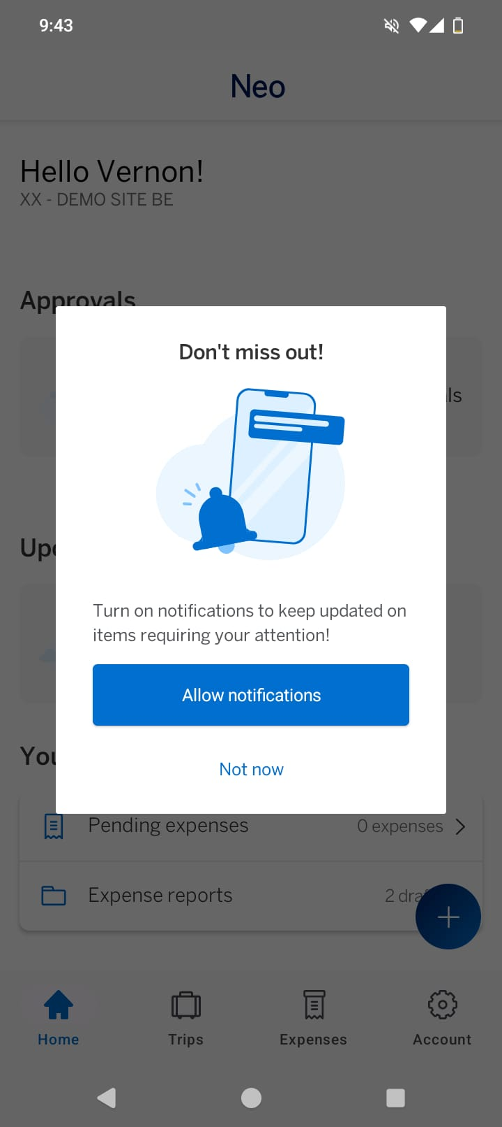
You can choose to allow Neo to send you notifications on your mobile by selecting ‘Allow Notifications’

Slide 12
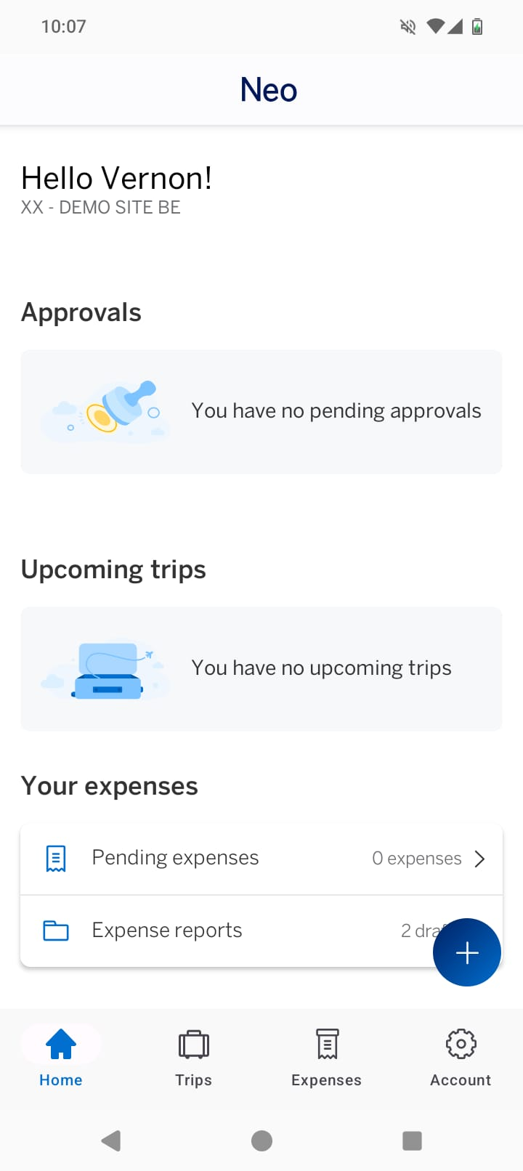
To access the settings and terms and conditions, select “Account”

Slide 13
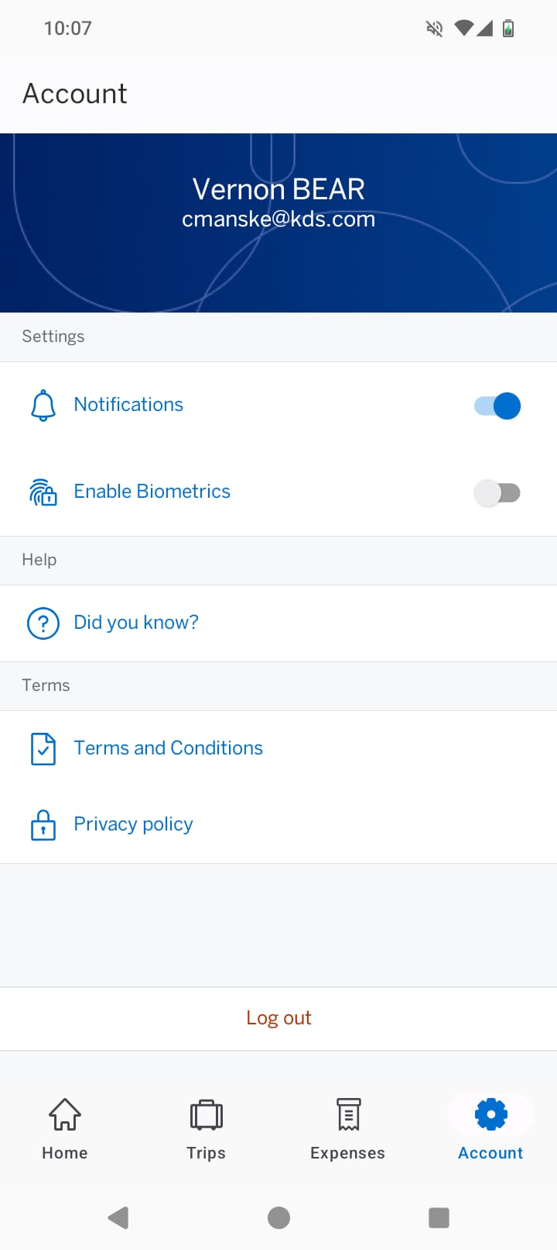
Under Settings, you are able to turn on/off notifications, enable biometrics or access the help centre (“Did you know?”), as well as the terms of conditions and privacy policy.

Slide 14
You are now ready to manage your travel and expenses with the Neo mobile app!

Slide 15

Travel and Expense.
Simplified.

