Slide 1


How to
Use the arranger interface
Neo User Guides

Slide 2
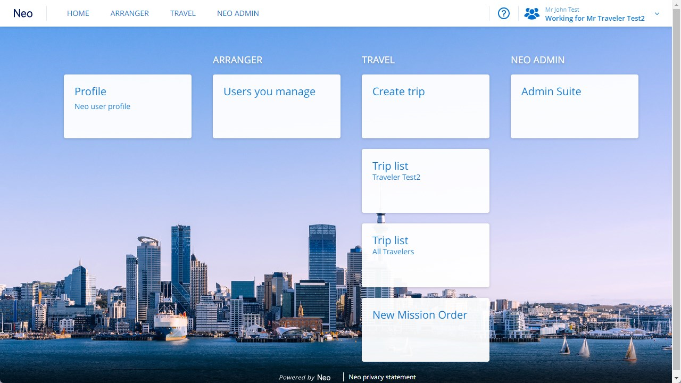
Select
“Users you manage”.

Slide 3
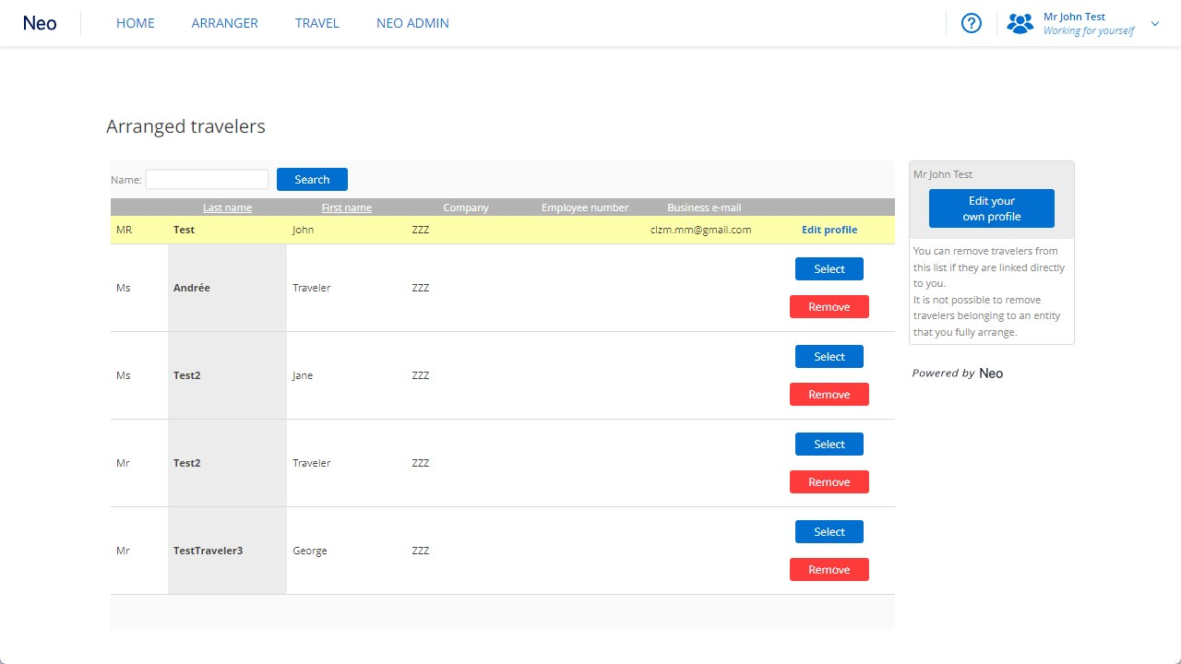
You can search travellers by name.

Slide 4
Select the traveller you want to manage travel or expense for,
by clicking
“Select”.

Slide 5
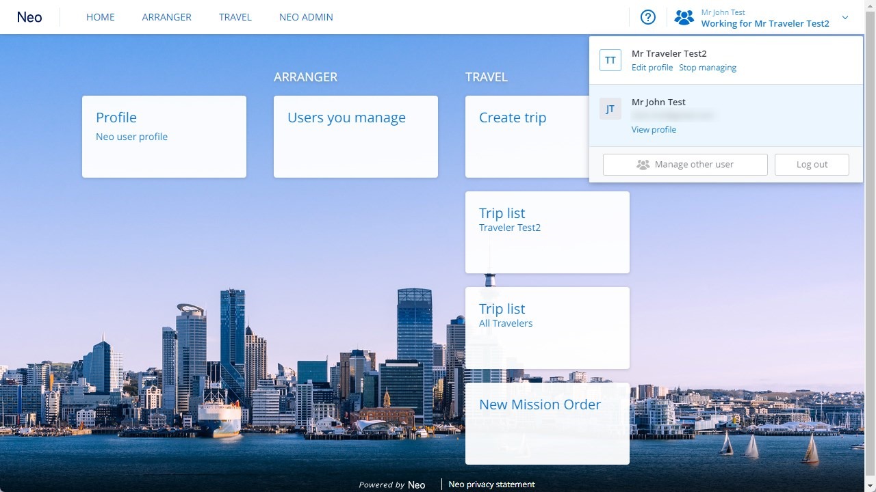
Click on the top right of the screen and select
“Stop managing”
if you want to now use Neo for yourself.

Slide 6
Click on the top right of the screen and select
“Stop managing”
if you want to now use Neo for yourself.

Slide 7

Travel and Expense. Simplified.

